Slide 1
Mental health
ruby

Slide 2
One.Talk about your feelings to someone you trust,this will help you to have a good mental health,and help you during tough times.

Slide 3
Two.Eat well because your brain needs a mix of nutrients in order to stay healthy and function well,just like the other organs.

Slide 4
Three.Take a break a change of scene or a change of food is good for your mental health.It could be taking half an hour to clean or read.

Slide 5
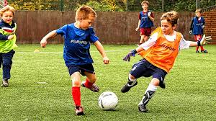
Four.Keep active do something you are good at such like running,playing football.

