Slide 1
Your Mental health
Mental health day!

Slide 2
mental health and what it is.
Everyone has mental health some peoples mental health doesn't work as good as other peoples. Some people are effected by there mental health. You might be effected by something that happened in the past or you could be going through now.
What is mental health?
Talking Mental Health - YouTube

Slide 3
Effects of mental health.
There are many effects of mental health here are some: self harm-depression-self esteem and a effect on your personality.
Different effects of mental health.

Slide 4
How to deal with mental health.
Ways to deal with mental health
Meditate
Write down your feelings.(you can share if you want)
Tell an adult about any stress
Express your self and your feeling
Follow your heart!
What should I do to calm my self?

Slide 5
Self love
You can try to listen to your thoughts or even go for a walk refresh your mind and love your self!
Ways to care for your self!

Slide 6
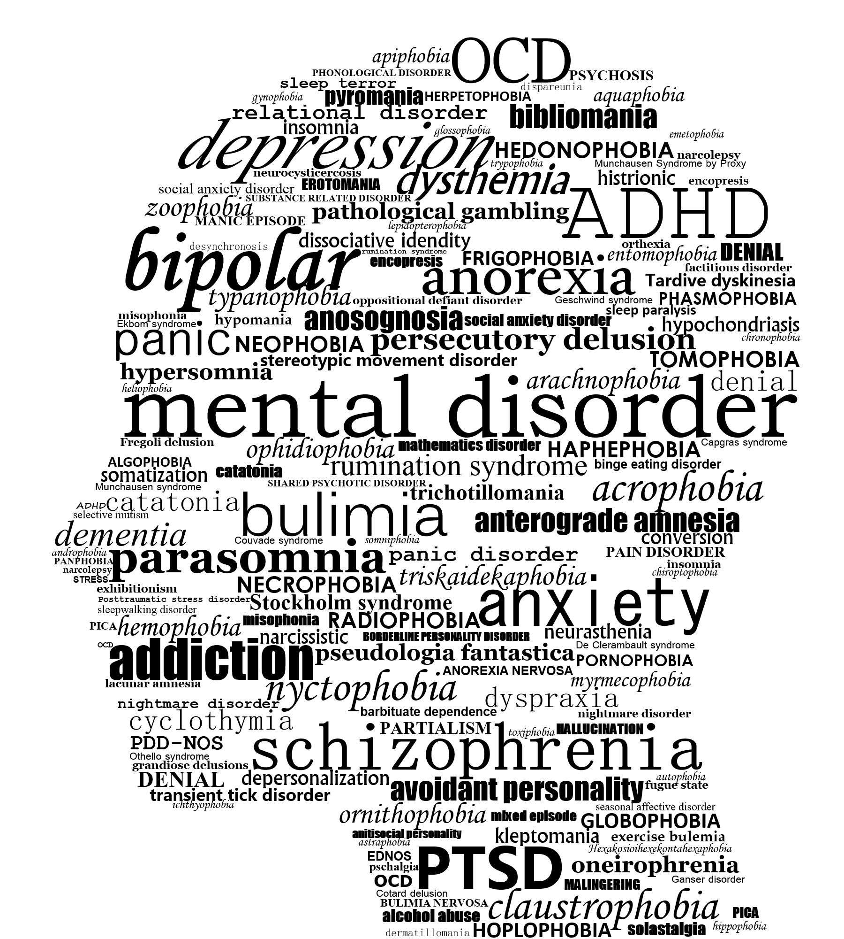
mental health
A nice pichture

