Slide 1
Emotional Regulation
Parent Café January 2024

Slide 2
What are we covering today?
Introductions – Zones of Regulation check-in
What is emotional regulation?
Why is it important?
The Zones of Regulation curriculum
How it looks at school
Applications at home
Resources and signposting – the zones of regulation website
Any questions?

Slide 3
Welcome! ☺
Introductions
Please say your name and what zone/s you are in right now.
You can give a reason for your zone, but you don’t have to.
Please be respectful when others are sharing their zone!

Slide 4
What is Emotional Regulation?
Social and Emotional Learning refers to the process through which children learn to understand and manage emotions, set and achieve positive goals, feel and show empathy for others, establish and maintain positive relationships, and make responsible decisions.
(Education endowment foundation, July 2021)

Slide 6
Why is emotional regulation important?
Good social and emotional skills developed by the age of ten, are predictors of a range of adult outcomes (age 42), such as:
life satisfaction
Wellbeing
Employment success
good overall health
There is evidence that children’s skills can be improved purposefully through school-based SEL programmes, and that these impacts can persist over time.
SEL can have positive impacts on a range of outcomes, including:
Improved social and emotional skills
improved academic performance
improved attitudes, behaviour and relationships with peers
reduced emotional distress (student depression, anxiety, stress and social withdrawal)
reduced levels of bullying
improved school connection.

Slide 7
Why is emotional regulation important?
Evidence reviews including over 700 studies show that on average SEL has a positive impact on academic attainment, equivalent to 4 additional months’ progress.
Interventions which focus on improving social interaction tend to be more successful than those focusing on personal and academic outcomes.

Slide 8
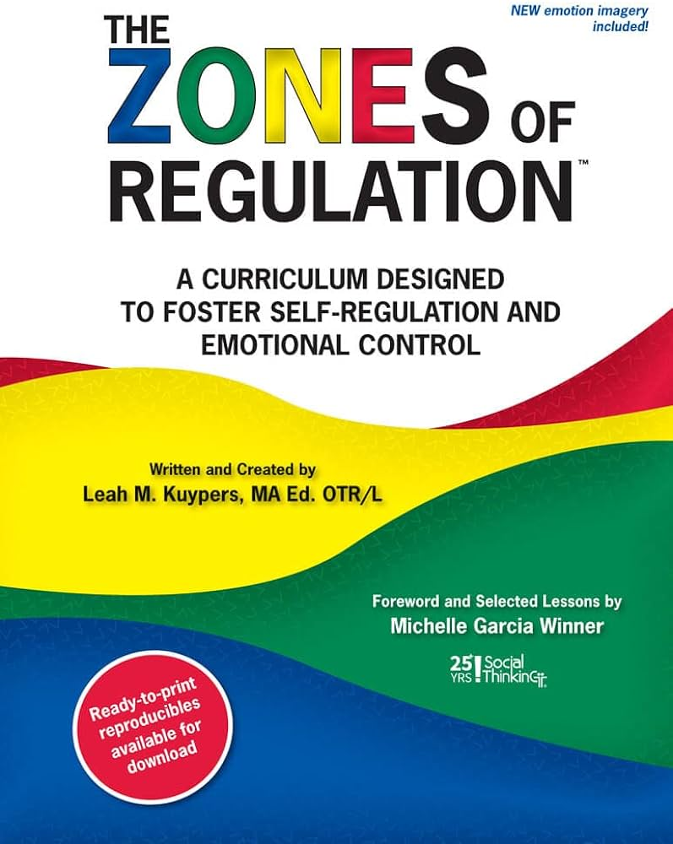
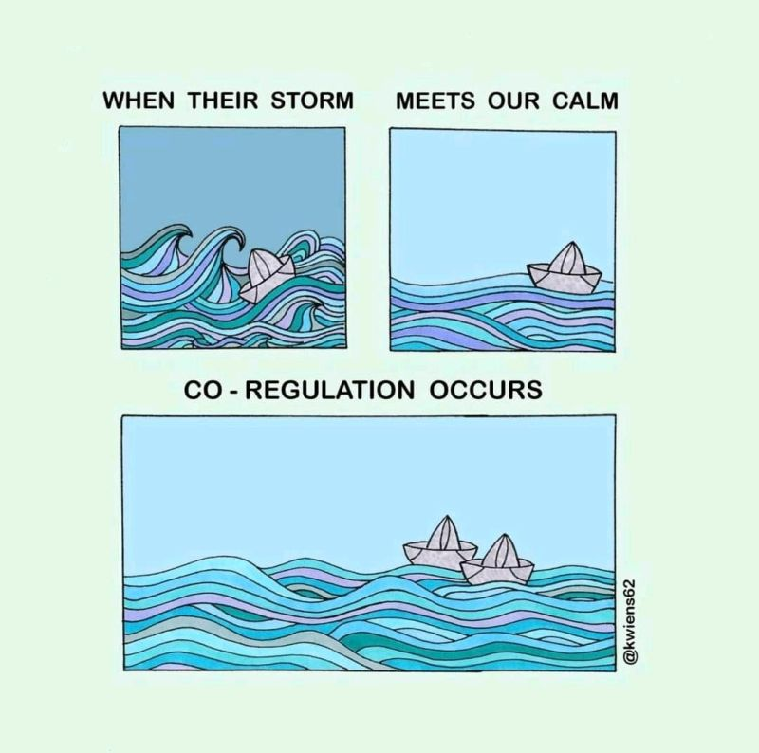
The Zones of Regulation Curriculum
The Zones of Regulation provides an easy way to think and talk about how we feel on the inside and sorts emotions into four coloured Zones, all of which are expected in life!
Curriculum of systematic lessons with developmental planning and related resources
A core belief of The Zones of Regulation is that all the Zones are okay. We routinely experience several of the Zones across a day.
A proactive, skills based, metacognitive approach

Slide 10
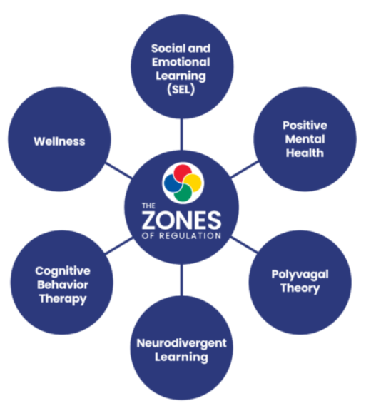
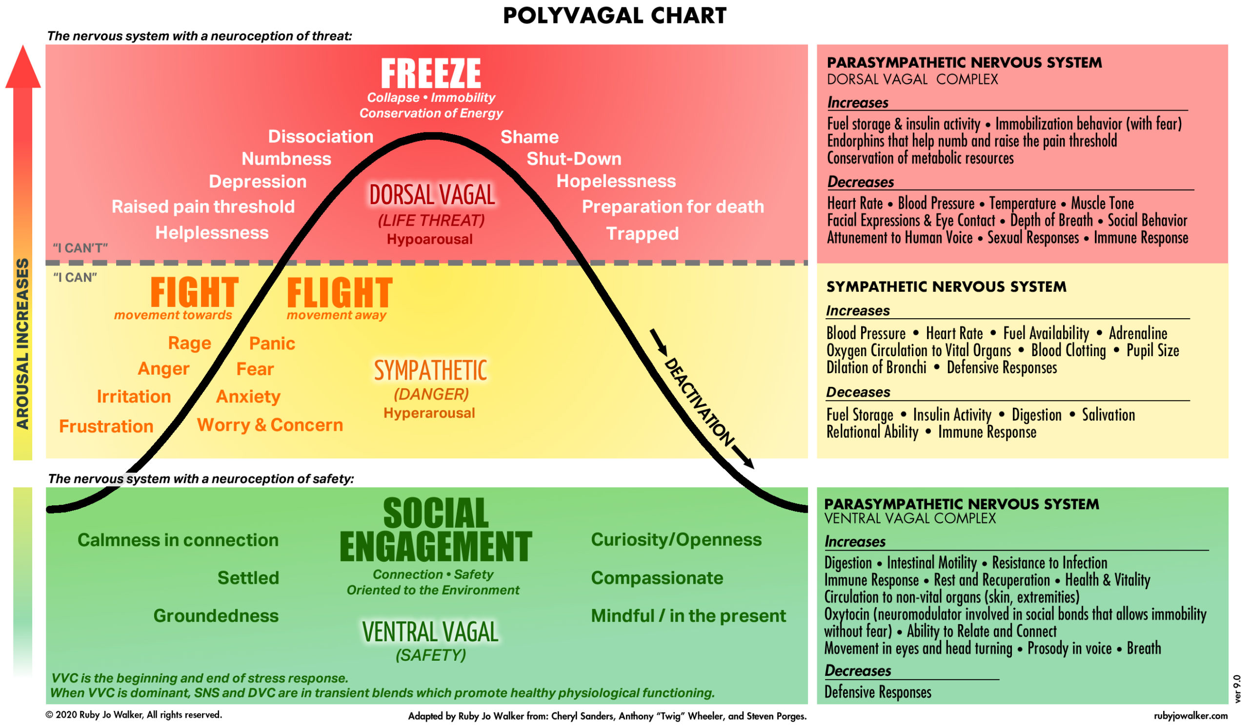

Slide 11
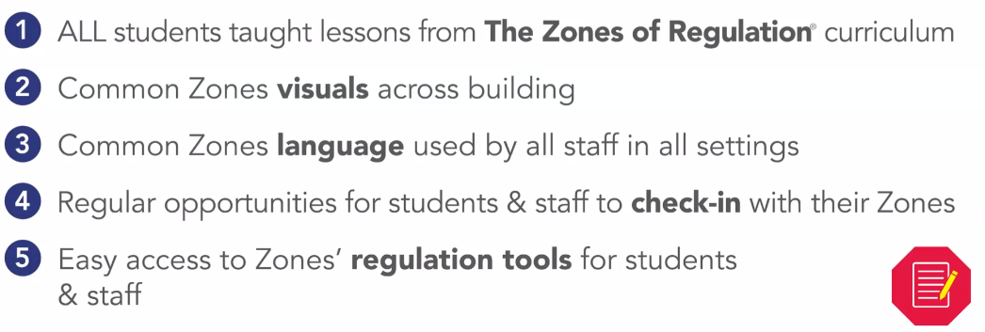
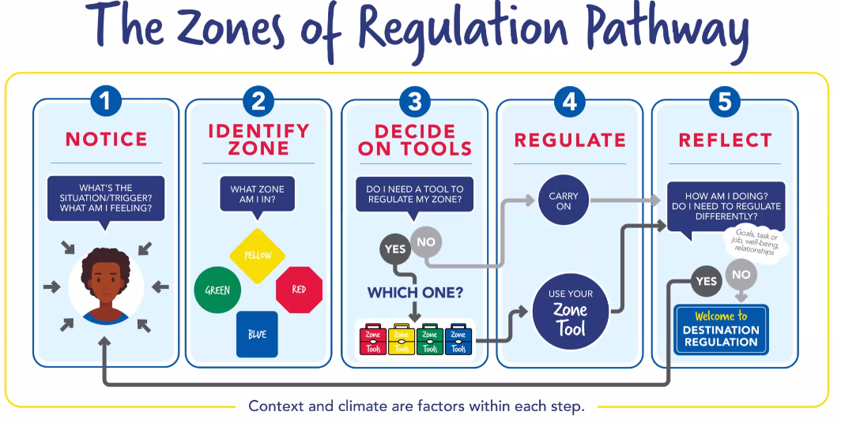
How does this look in school?

Slide 12
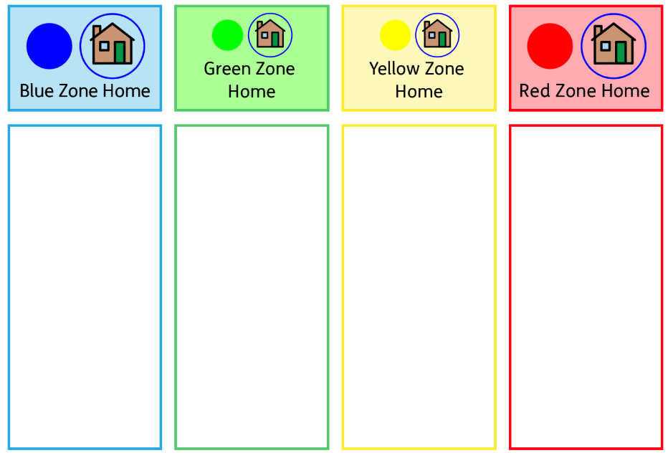
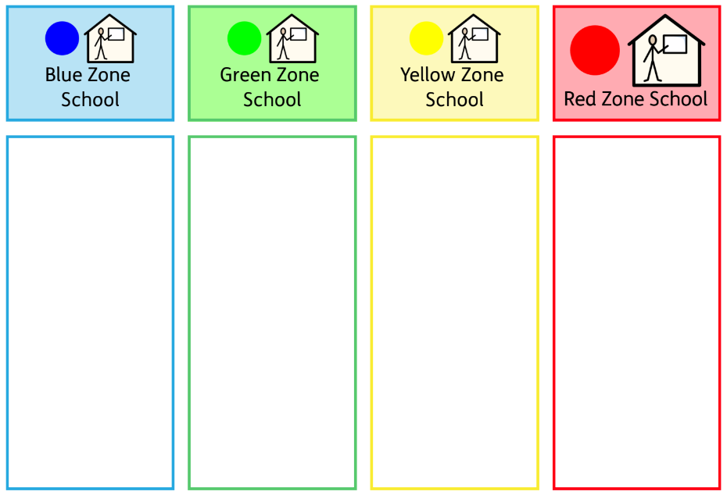
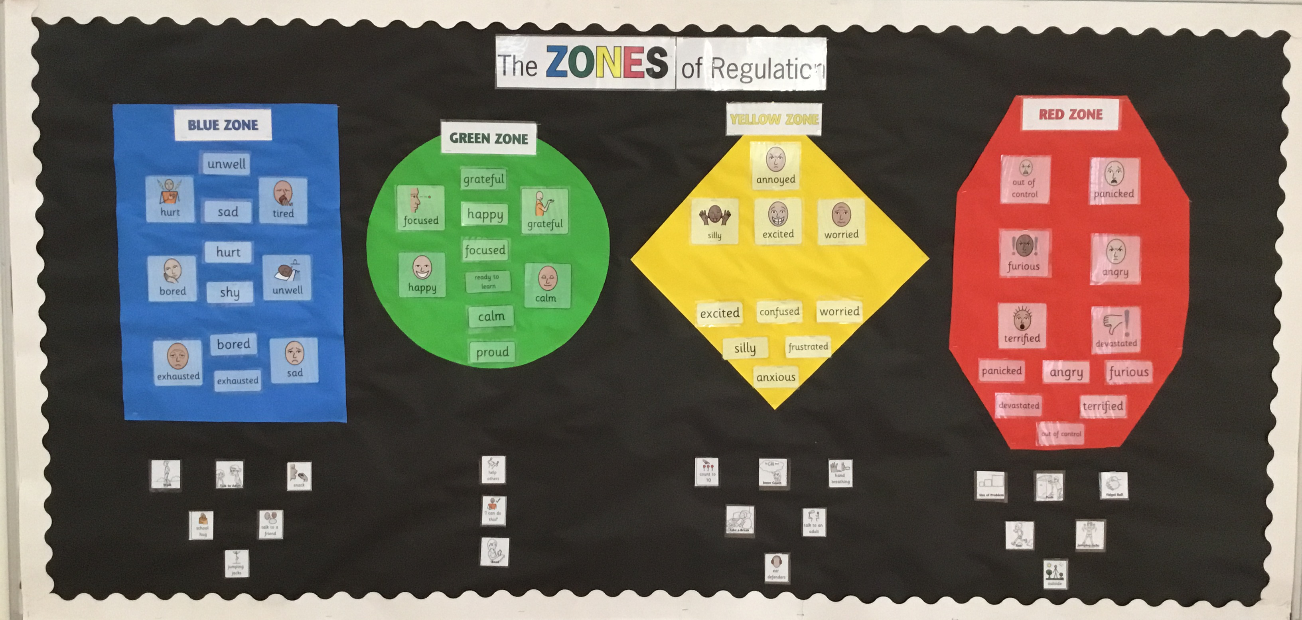
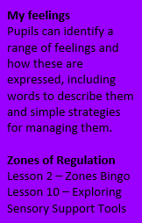
A few examples at school
Pupil Voice
Check-in times – morning, after playtimes, end of the day. Adults will also check in, to model the language.
Class text/story time – how are the characters feeling? Why? What strategies could they use? Having a character from your class text on the zones check-in!
Restorative conversations during or following an incident. How were you feeling? What strategy could we use next time?
Whole class strategies – tools children can use in each zone for the whole class
Zones of regulation profiles/risk management plans
Within the PSHE Curriculum
Coming soon – as part of our behaviour/relationships policy

Slide 13
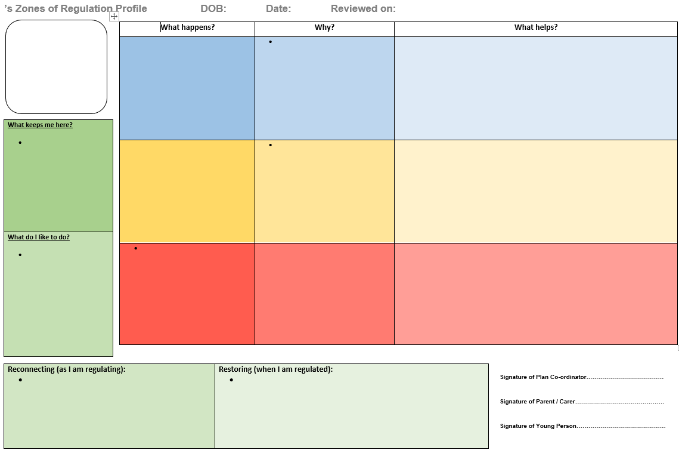
Zones of Regulation Profiles - supporting behaviour

Slide 15
Using scripts
Time and space is the number one strategy to support someone who is dysregulated
If you need to communicate verbally, using scripts is best
Scripts are predictable, consistent and safe, they support both the adult and child to regulate
Scripts support a trauma informed PACE approach
e.g.
“It is OK to feel ____, but it is not OK to ____”
“I am here when you are ready”
“What strategy could you choose? *show two visual choices*”
“Thank you for telling me”

Slide 16
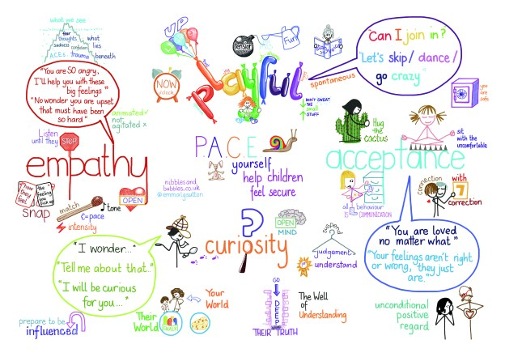
The PACE Approach
PACE is an approach developed by Dr Dan Hughes, an American psychologist who works with children who have experienced trauma.
These principles help to promote the experience of safety for young people. Children need to feel that you have connected with the emotional part of their brain before they can engage the thoughtful, articulate, problem solving areas.
“Connect and redirect: When a child is upset, connect first emotionally, right-brain to right-brain. Then, once the child is more in control and receptive, bring in the left-brain lessons” - The Whole Brain Child, Daniel J. Siegel and Tina Payne Bryson

Slide 17
What outcomes do we want to see?
Increase in overall wellbeing, positive mental health, self-esteem, resilience and outcomes into adulthood!
Social, emotional and mental health needs being met
Pupils being able to express their emotions and regulate their behaviour, resulting in less masking and dysregulation

Slide 18
Applications within the home
The Zones of Regulation can be used within the home as much or as little as you feel would support the needs of your child!
The simplest way to start to use the zones at home, is by having a visual ‘check-in’ resource within the home, that your whole family use to discuss their emotions.
Personalised at home strategies would be the next step in supporting your child to regulate their emotions at home
If you want to think about your child’s zones in depth, you could look at a home ‘zones profile’.

Slide 19
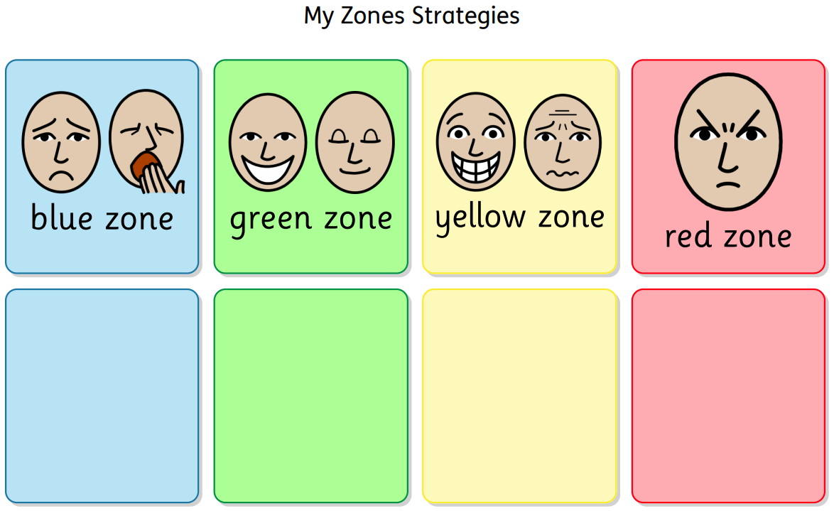
Activity! – Personalised strategies
Choose one of the zones strategy/ toolkit templates to write some strategies that you think would support your child to regulate at home.
Here is an example:
Jumping jacks
Talk to an adult
Snack or drink
Garden
Breathing
Talk to an adult
Sensory toys
Trampoline
Time in my bedroom
Playdough

Slide 20
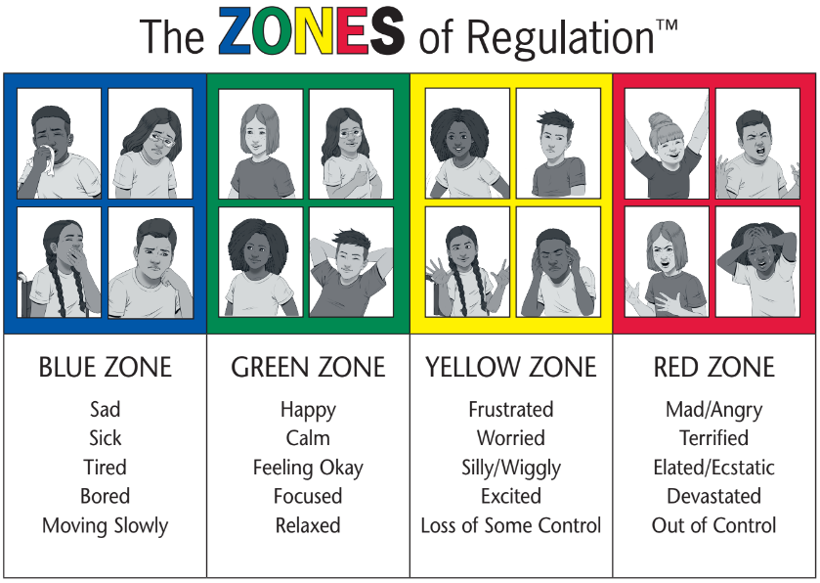
Resources and signposting
Resources to take home today:
Zones of Regulation visual check in for the home
Personalised strategy ideas for your child
Signposting for further resources, information and support:
https://zonesofregulation.com/
Website demo!
https://www.drake.norfolk.sch.uk/the-zones-of-regulation-1/ - a new page coming soon!
https://hes-extraordinary.com/the-zones-of-regulation
https://www.theottoolbox.com/zones-of-regulation-activities/

Slide 21
Thank you! ☺
Any questions?

