Slide 1
Bawdsey Manor 2024
Year 4 Residential
Monday 25th- Wednesday 27th March 2024

Slide 2
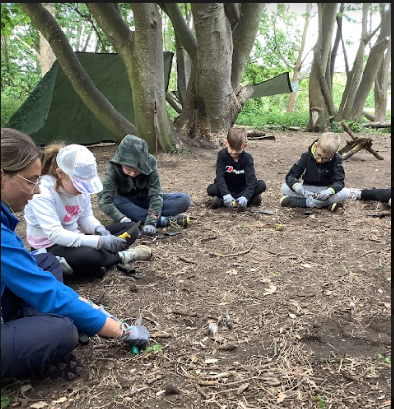
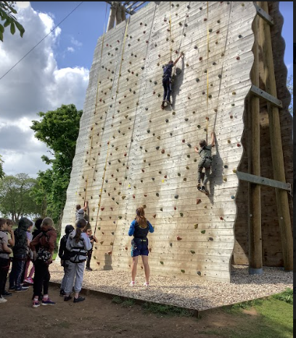
Agenda
Kit List
Food
Accommodation
Activities
Shop
Peace of Mind

Slide 3
Staff attending
Mr Adair
Mrs Farraway
Miss Sprague
Miss Farish
Mrs Chapman (Tuesday)
Miss Roberts

Slide 4
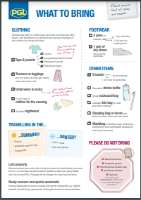
Kit List
This has been emailed to you all.
However, if you would like a paper copy of the list,
please help yourself at the end of the meeting.
No mobile phones or electronics please.
Please ensure everything is named.

Slide 5
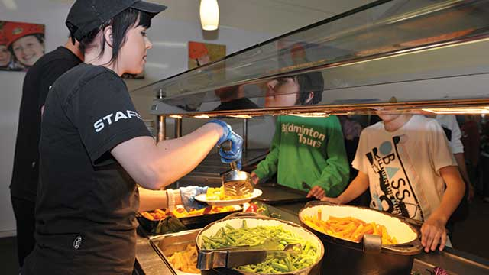
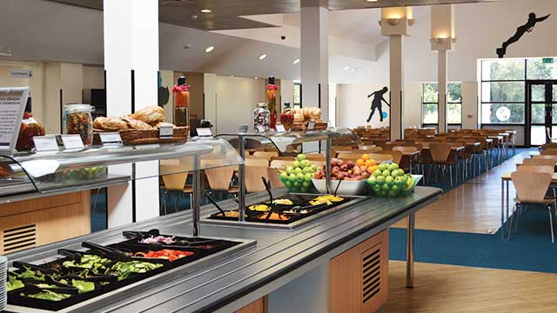
Food
We know that some children are very particular about what they eat and if the menu doesn't suit, we can provide alternatives to ensure no-one leaves the dining room hungry. We do often find, however, that children are more likely to try new things at PGL that they wouldn't normally eat at home - it's all part of the PGL experience!

Slide 6
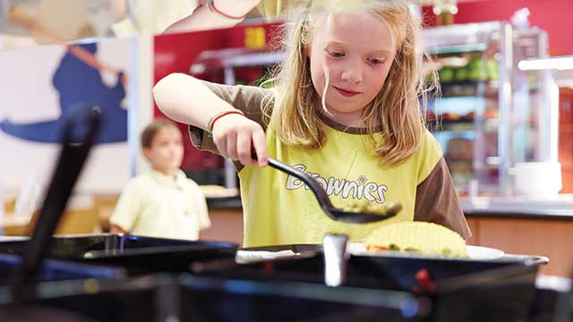
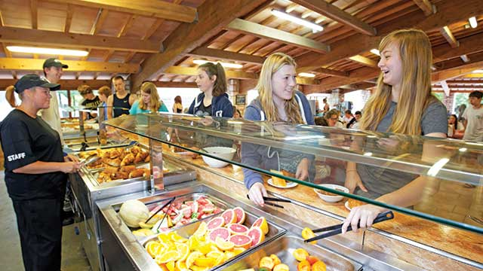
Food
There are freshly-prepared hot or cold options available at every mealtime and a self-service salad bar for children to help themselves to as much salad as they like at lunch and dinner. Homemade soup is available most days and there is plenty of bread and fresh fruit available, as well as hot and cold drinks.
For the safety of others, please do not bring any food items that contain nuts to our centres.

Slide 7
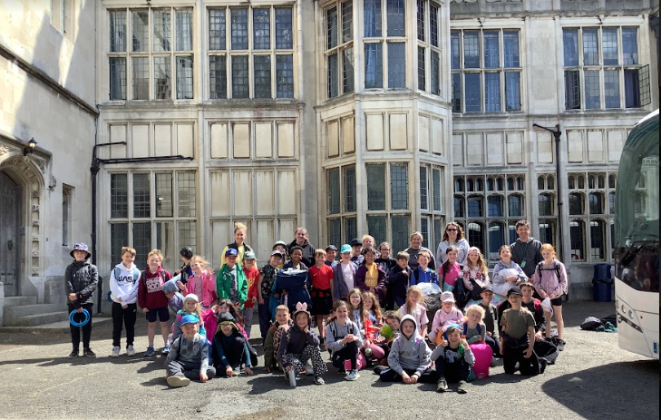
Accommodation
Children will be sleeping in rooms of 4 to
6. These have been carefully allocated
based on friendship groups and individual needs. This year we are staying in the new
block at Bawdsey Manor.
Each room has its own ensuite bathroom, including showers.
Staff will be dotted around between the rooms, so there will always be someone on hand to help. The staff at Bawdsey are also on hand at all times.

Slide 8
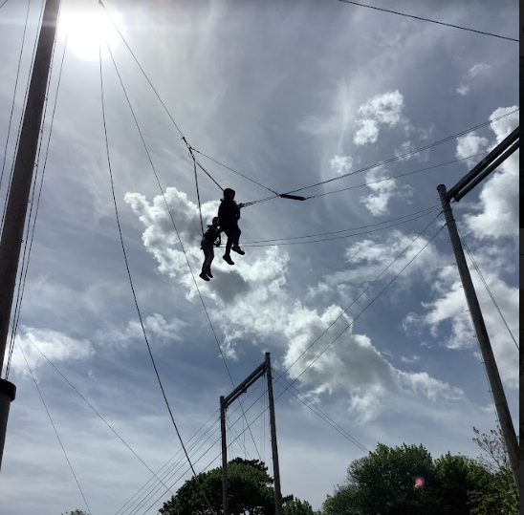
Activities
All PGL's adventure activities take place under the instruction and guidance of specially trained PGL instructors who prioritise safety above all else. This time activities take place on land and in the air (for our rope-based challenges), so each brings a different (and fun!) way for children to challenge themselves in a friendly, safe and supportive environment.
Activities include:
Abseiling, archery, zipwire, climbing, sensory trails, giant swing, challenge course, problem solving, balloon splash, passport to the world

Slide 9
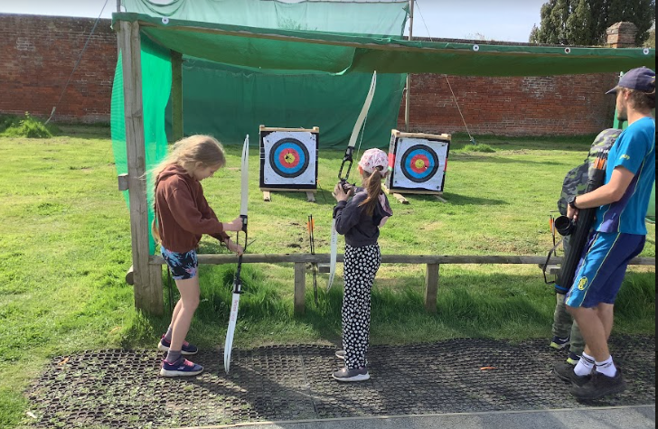
Shop
Our fully stocked on-site shops are the perfect places for your child to pick up a few treats during their trip. All school groups will have the opportunity to visit our on-site shop once during their stay, with the visit proving a fantastic chance for pupils to strengthen communication skills, work on their mental maths development, and grow in independence as they take responsibility for purchasing their own treats!
Please ensure that your child has no more than £10 for the shop. Thank you.

Slide 10
Peace of Mind
Are all staff DBS Checked? All staff are DBS checked
Are all staff instructors fully qualified? Yes, all our instructors are carefully selected, highly trained and meet the requirements laid down by national governing bodies, including The Adventure Activities Licensing Authority (AALA), The British Activity Providers Association (BAPA) and the Council for Learning Outside the Classroom (LOtC).

Slide 11
Peace of Mind
Can I contact my child whilst they are away?For many children, part of the learning experience is about being away from home, sometimes for the first time. We would ask parents to allow their children to settle in and enjoy the experience.In the case that you need to contact your child, please contact the teacher or Party Leader in charge of the trip on the emergency number they have provided you with.
It’s my child’s birthday when they away. If the Party Leader is aware of this, we will be happy to arrange a birthday card and a VIP sticker entitling the birthday boy or girl to special privileges throughout the day; for example queue jumping for meals and activities. Happy Birthday will be sung during the day in an appropriate place.

Slide 12
Questions?
If you have any questions, please email the office and Mr Adair and Mrs Farraway will be more than happy to help.
office@drake.norfolk.sch.uk

