Slide 1
READING CAFE
Year 5

Slide 2
Reading for pleasure
There is a growing body of evidence which illustrates the importance of reading for pleasure for both educational purposes as well as personal development (cited in Clark and Rumbold, 2006).
Evidence suggests that there is a positive relationship between reading frequency, reading enjoyment and attainment (Clark 2011; Clark and Douglas 2011).
Reading enjoyment has been reported as more important for children’s educational success than their family’s socio-economic status (OECD, 2002).
There is a positive link between positive attitudes towards reading and scoring well on reading assessments (Twist et al, 2007).
Regularly reading stories or novels outside of school is associated with higher scores in reading assessments (PIRLS, 2006; PISA, 2009).
Notes:
There is a growing body of evidence which illustrates the importance of reading for pleasure for both educational purposes as well as personal development (cited in Clark and Rumbold, 2006).
Evidence suggests that there is a positive relationship between reading frequency, reading enjoyment and attainment (Clark 2011; Clark and Douglas 2011).
Reading enjoyment has been reported as more important for children’s educational success than their family’s socio-economic status (OECD, 2002).
There is a positive link between positive attitudes towards reading and scoring well on reading assessments (Twist et al, 2007).
Regularly reading stories or novels outside of school is associated with higher scores in reading assessments (PIRLS, 2006; PISA, 2009).

Slide 3
What our children think about reading

Slide 4
National curriculum Reading – comprehension
There is a huge amount that children have to achieve in reading along within the national curriculum.
Some of the key areas are:
Maintaining positive attitudes to reading by reading an increasingly wide range or texts
Reading for different purposes
Making comparisons within texts
Asking questions about what they have read
Discussing ideas and challenging the ideas of others courteously, whilst building on their own ideas
Providing reasoned justification for their ideas
Retrieving evidence and recording and presenting this information from non fiction
And so much more…….

Slide 5
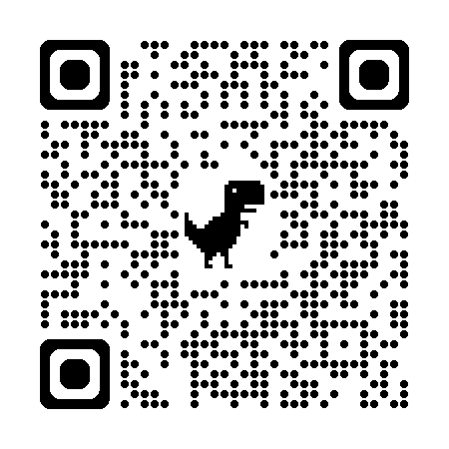
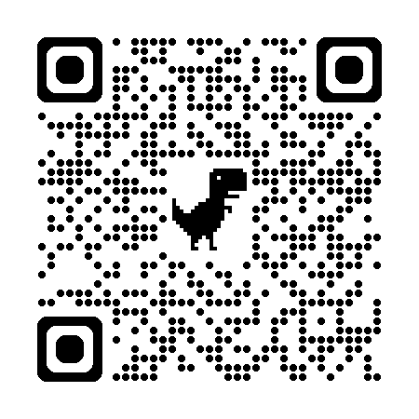
Reading in our school - what we do
Daily RWI sessions where every child reads every session
Daily reading of high quality class text books by teachers and TA’s- Reading out loud gives children a scaffolds of how to use expression, pace and how to self-correct
1:1 reading with class teacher at least once every three weeks
Range of ORT/Big Cat and RWI books
2 libraries – we have 4000 books available and counting
Children visit the school library every week
Sora reading app - children can read books and listen to audiobooks at home
Visit Thetford library
100 books to read in Year 5
https://www.thereaderteacher.com/
https://soraapp.com/library/ukprimary

Slide 6
Reading at home
Expectation : ideally 10-15 minutes per day.
Try to build this into your daily routine
Have a quiet, comfortable space your child (and you) can read in.
Read with and to your child
Use the reading diary insert to ask questions before, during and after reading.
Please write a short comment into the ‘comments’ box

Slide 7
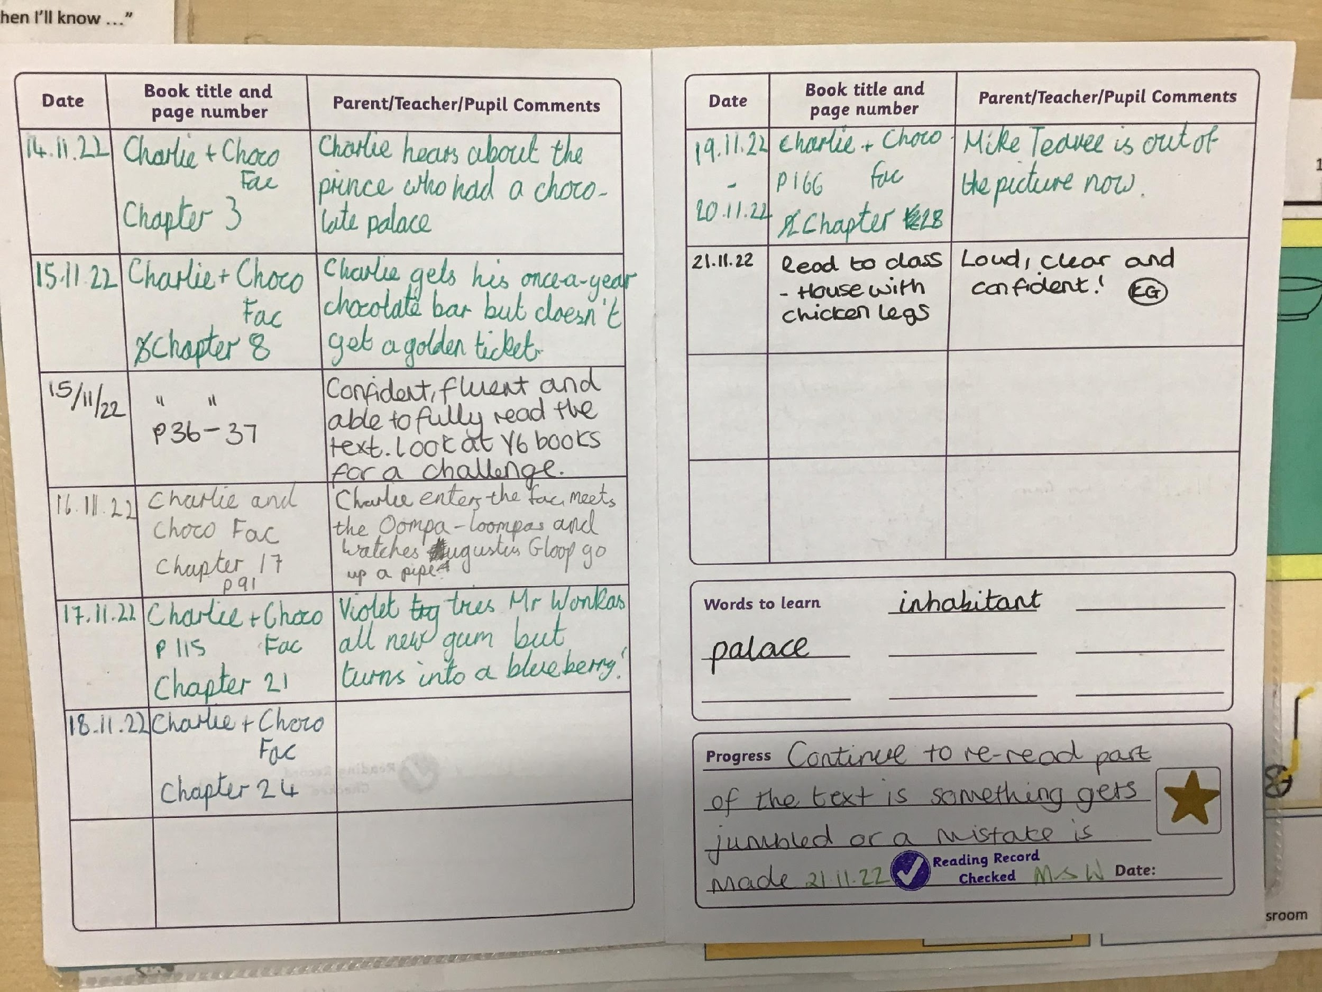
Reading diaries
Here is an example of a double page spread which is on our Spring newsletter of last year. The child has commented on their reading by summarising what has been read, they are adding in unknown words to refer back to or to use in their own writing and the progress box is filled in by the class teacher, including a next step.

Slide 8
Reading diaries
At the front of each reading diary there are questions to ask and comment suggestions
Each reading diary is checked every Monday and stamped ‘ Reading diary checked’.
On the Monday, if your child has read and commented 7 times in the previous they will get their star.
Notes:
EMPHASIZE THE IMPORTANCE OF READING AT HOME WITH THEIR CHILD:
Regularly reading to a child for the love of it provides a connection between parent and child from the very early days and helps build strong family ties. Lines from favourite stories enter the family lexicon. Families who enjoy reading together have more opportunities for discussion, developing empathy and attachment. Reading to their child is one of the greatest gifts parents can give. By starting the journey of building a lifelong love of reading for pleasure, parents are giving their child the opportunity to be the best they can be: children who read for pleasure do better in a wide range of subjects at school and it also positively impacts children’s wellbeing. Our best readers = our best writers
Reading is a great habit. Like all habits, it needs repetition and regularity to establish itself. Because it needs quiet time, and our lives today are very short of this, parents need to create it for their children. This means consciously making time and keeping interruptions to a minimum.

Slide 9
Reading to your child
It is really important to read to your child. This is an opportunity for them to hear stories and language at a higher level than they can read alone. Research shows that hearing texts read aloud is a significant source of vocabulary acquisition.
Most new vocabulary is acquired through reading. Adult spoken language ranks lower in word complexity than that found in children’s books.

Slide 10
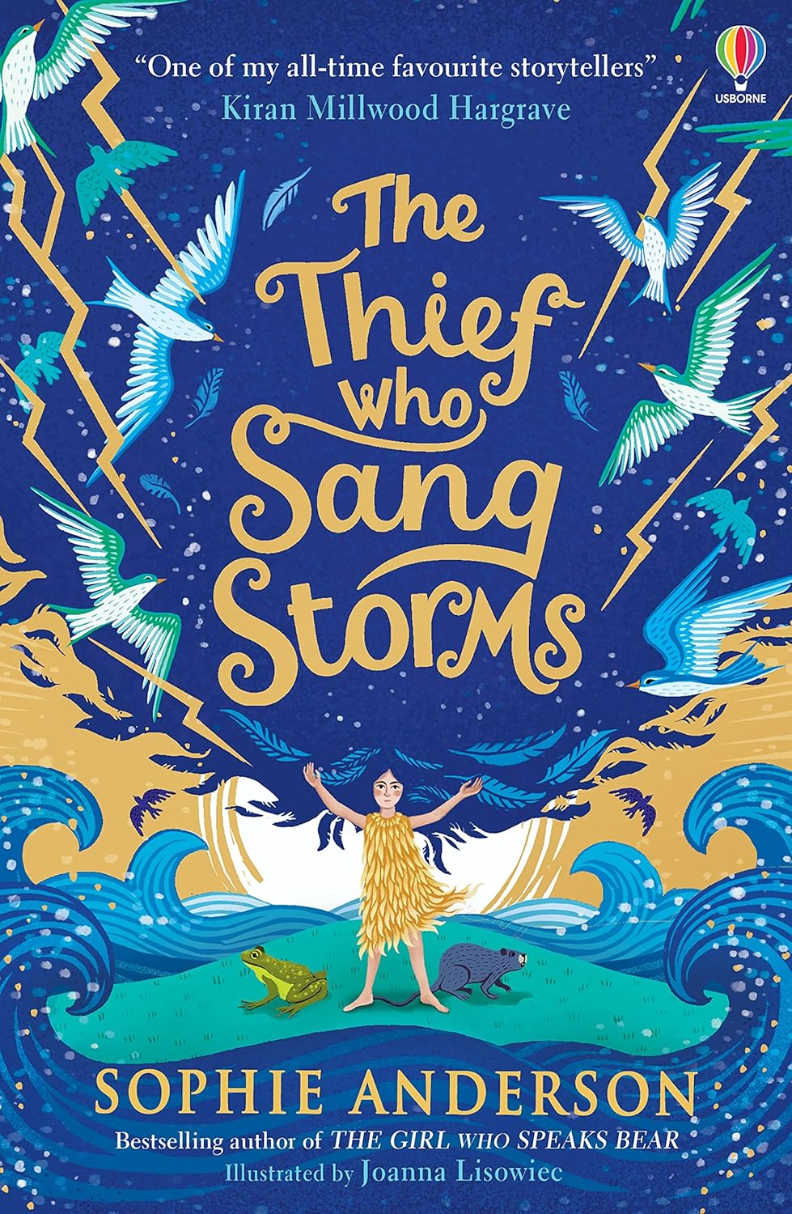
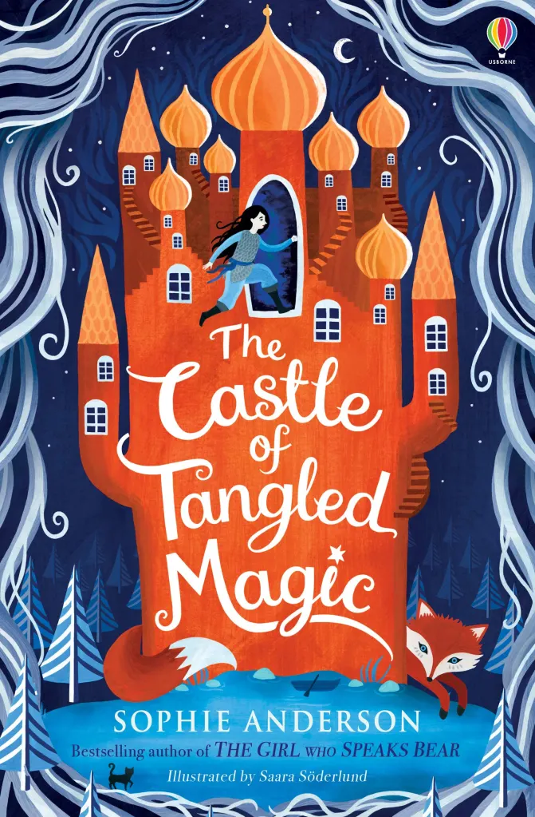
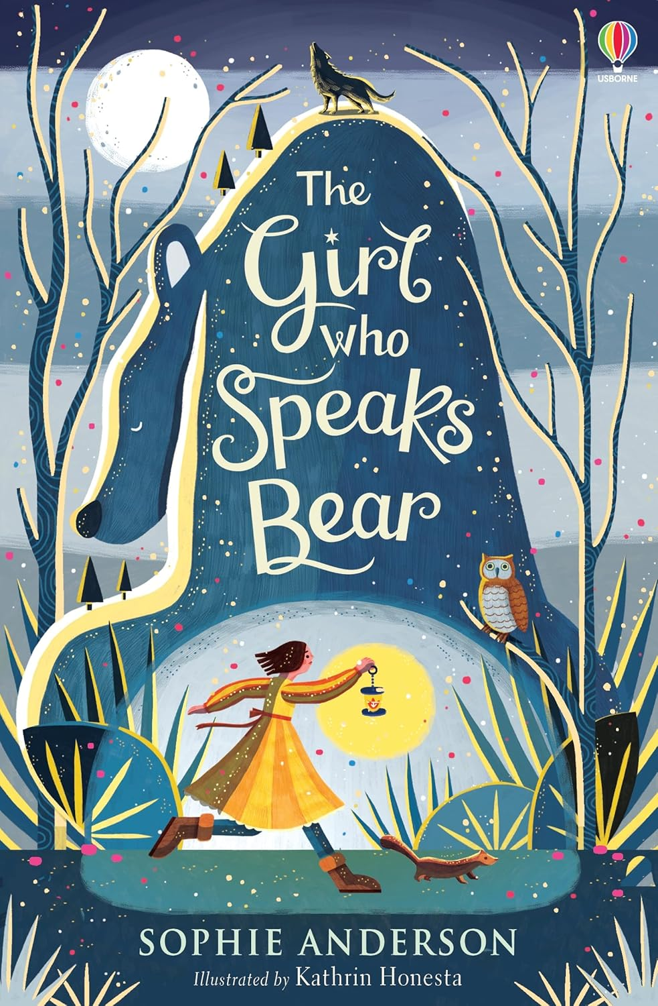
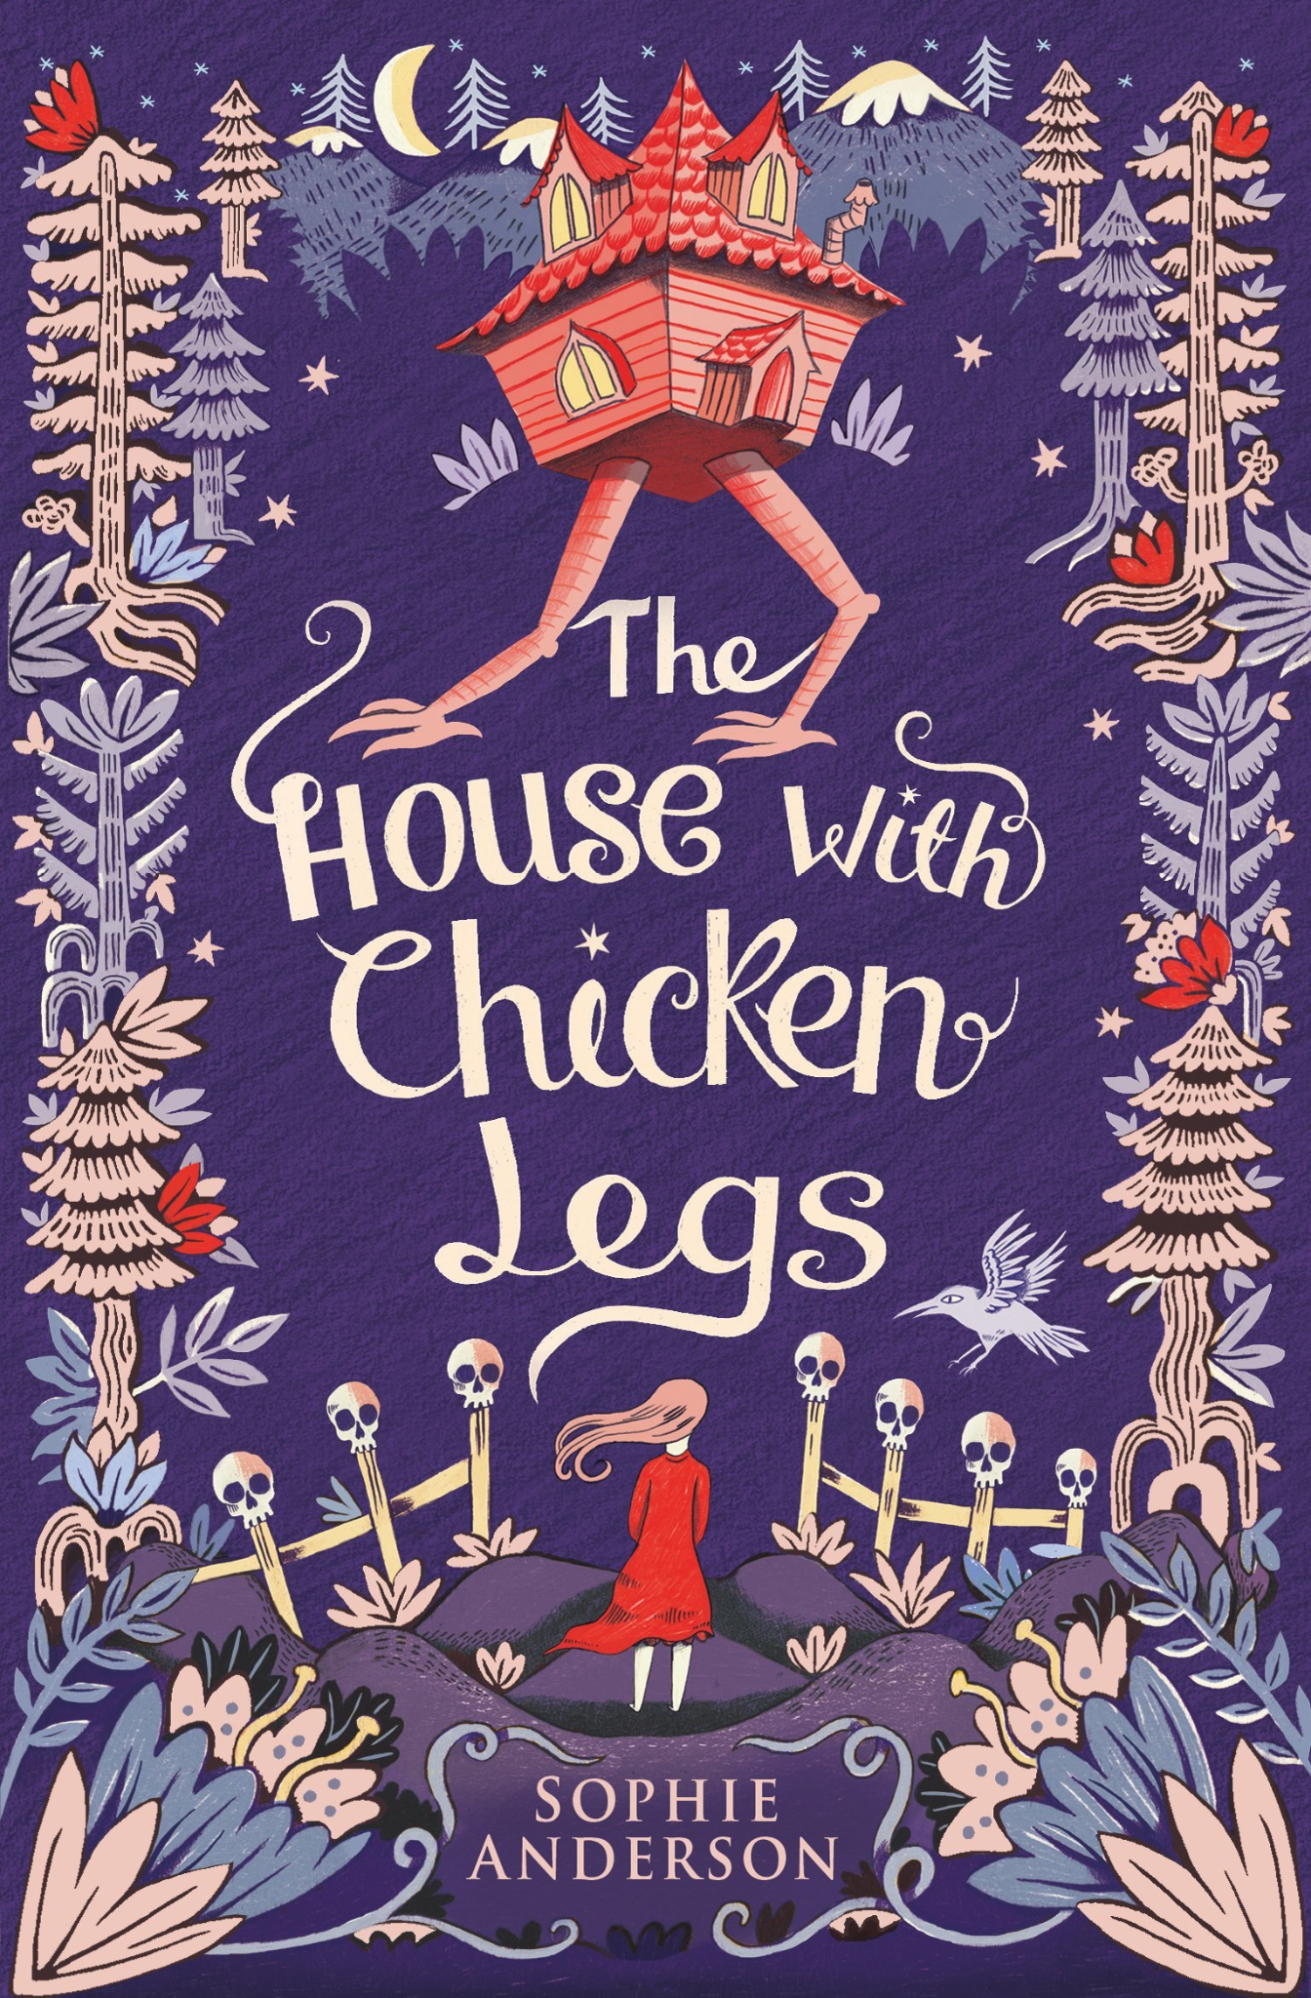
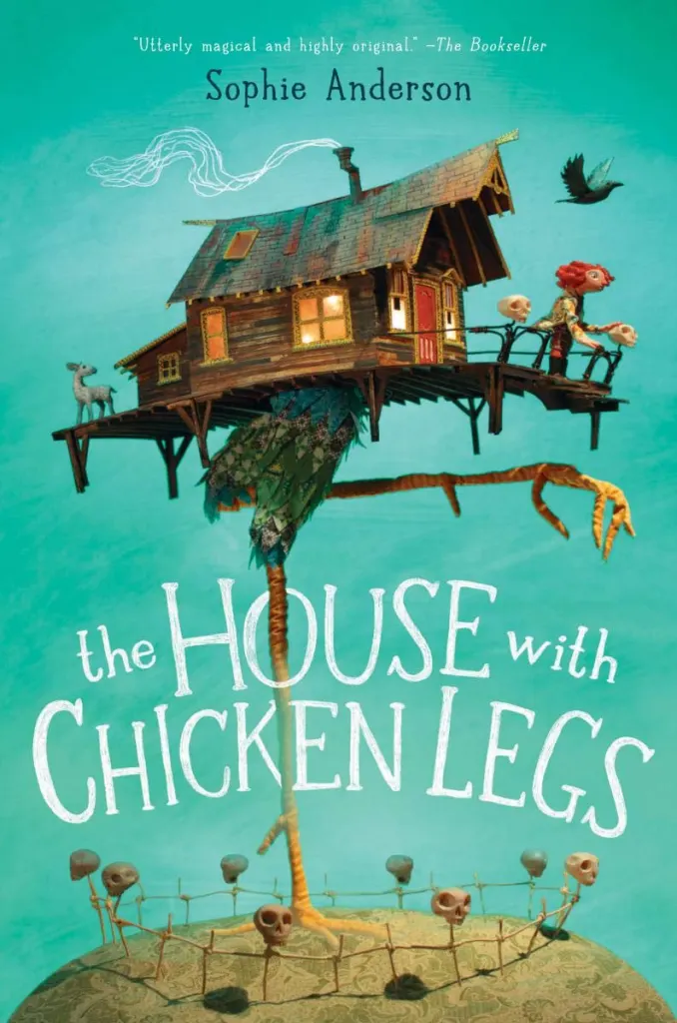
The House with Chicken Legs
Sophie Anderson

Slide 11
Time Capsule
When the dead gather in the house, they bring with them special memories of their lives. What are your special memories? Create a box using the template and create a time capsule. Draw pictures of things that represent your identity and something you would want to put in your capsule.
Task Choices
Descriptive Writing
The house travels to new locations when it chooses to. Draw a picture of where you would like ‘The House with Chicken Legs’ to take you. Write a paragraph to describe it. Use your senses to bring your paragraph to life.
Book Cover
Design your own book cover. This can be for the House with Chicken Legs or it can be for your House with _____ Legs. You need to include a title and image just like the covers of Sophie Anderson books.

